Slide 1
Five Number Summary Introduction
Year 10 Mathematics Essentials

Slide 2
Lesson OutComes
2.1.9 Calculate and interpret quartiles

Slide 3
24
7
30
Topic: Five Number Summary
Date: 19/07/2018
EQ – What is the Five Number Summary?
The 5 number summary can be found for any set of numerical discrete data.
The 5 number summary consists of :
The median (2nd quartile)
The 1st quartile/Lower Quartile (Q₁)
The 3rd quartile/Upper Quartile (Q₃)
The maximum value in a data set
The minimum value in a data set

Slide 4
Total Physical Response ACtivity
You will be given 60 seconds to write the letter x as many times as possible with your dominant hand, (the one you use to write with).
As you have two hands, you will be given 60 seconds to write the letter x as many times as possible with your non-dominant hand.

Slide 5
Total Physical Response ACtivity
Dominant Hand Minimum: Maximum: Median: Lower Quartile (Q₁): Upper Quartile (Q₃):
Non Dominant Hand Minimum: Maximum: Median: Lower Quartile (Q₁): Upper Quartile (Q₃):

Slide 6
24
7
30
Topic: Five Number Summary
Date: 19/07/2018
EQ – What is the Five Number Summary?
Determining the 5 number summary
Minimum is the lowest value of the data set
Maximum is the highest value of the data set
Median
Order the data from smallest to largest
If there is an odd number of data points, the median is the middle value
If there is an even number of data points, the median is the average of the two middle values.

Slide 7
24
7
30
Topic: Five Number Summary
Date: 19/07/2018
EQ – What is the Five Number Summary?
Determining the 5 number summary
1st quartile/Lower Quartile (Q₁)
The middle value of data in the lower 50% of the values in the data set
The 3rd quartile/Upper Quartile (Q₃)
The middle value of data in the upper 50% of the values in the data set

Slide 8


Slide 9
Task
Complete the 5-number summary worksheet.

Slide 10
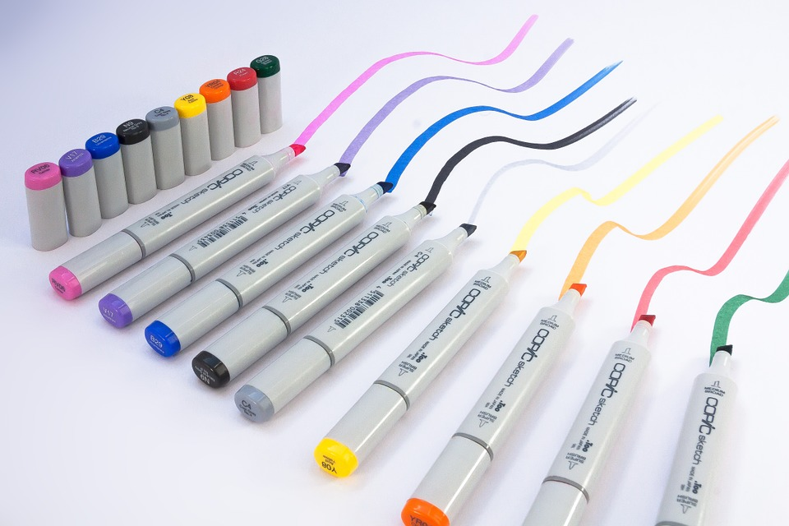
Leave Your Mark
You will be given a data set and a whiteboard marker.
You will need to determine the 5 number summary.
Show your working out on your desk.
Show me your work before you pack up.
YES. You. Will. Be. Writing. On. The. Desk.

